Slide 1
homelessness,
01
01
02
02
03
03
mental healthcare access,
and the limits of public data.
BACKGROUND
BACKGROUND
ASSESSMENT
ASSESSMENT
RECOMMENDATIONS
RECOMMENDATIONS
Stakeholder-informed research
CNM Ingenuity Deep Dive Data Science Bootcamp Capstone
Eljay Smith
Celeste Fischer
Raven Otero-Symphony
6.26.2026
Investigating what public data can - and cannot - tell us about healthcare access and housing stability in New Mexico.
Notes:
We began this capstone with a simple goal: investigate a question that matters to professionals working directly in homelessness services.
Rather than starting with a dataset, we started with a real-world problem and asked whether public data could help us understand it.
What we discovered ultimately changed the direction of the project.

Slide 2



introductions
01
01
02
02
03
03
who we are
BACKGROUND
BACKGROUND
ASSESSMENT
ASSESSMENT
RECOMMENDATIONS
RECOMMENDATIONS
data
Eljay Smith
Celeste Fischer
Raven Otero-Symphony
Mental Health &
Housing Stability Advocate
Lived Experience • Public Interest Data
GitHub: \eljaysmithdata
Nurse, Data Scientist, Healthcare Analytics Enthusiast
LinkedIn: \celestial-nights
GitHub: \Celeste1221
Senior Data Analyst, CYFD-JJ
Data Scientist • NASA • Policy
LinkedIn: \raven-dos
GitHub: \raven-in-space

Slide 3
SECTION 1:
BACKGROUND

Slide 4
the origin
01
03
01
02
a question grounded in service-provider experience
Our project began with an informational interview with Korina Lopez, grounded in years of shared homeless-service experience.
INTRO
BACKGROUND
ASSESSMENT
RECOMMENDATIONS
Service- Provider Experience
Informational Interview
Research Direction

Slide 5
the context
01
03
01
02
our question focused on one relationship within a larger system
HOUSING STABILITY
MENTAL HEALTHCARE
ACCESS
Housing Services
Transportation
INTRO
BACKGROUND
ASSESSMENT
RECOMMENDATIONS
PROJECT
FOCUS
Income & Benefits
Primary Healthcare

Slide 6
the question
01
02
03
Treatment access, housing stability, and New Mexico public data
?
Treatment Access
Housing Stability
BACKGROUND
ASSESSMENT
RECOMMENDATIONS
“Does stronger access to mental healthcare align with greater housing stability for people experiencing or at risk of homelessness in New Mexico?”

Slide 7



the framework
🞧
01
02
03
Three definitions guided what we looked for
BACKGROUND
Mental Healthcare
ASSESSMENT
Housing stability
Public data
RECOMMENDATIONS
Ability to obtain and continue needed treatment
Service availability
Ability to enter treatment
Continuity of care
Ability to obtain and maintain housing over time
Housing placement
Housing retention
Returns to homelessness
Information available without restricted agency access
Publicly accessible
Local relevance
Ability to connect measures
data

Slide 8
the plan
01
03
01
02
How we investigated the question
1
2
3
4
INTRO
BACKGROUND
ASSESSMENT
RECOMMENDATIONS
Find public data
Review sources
Compare evidence
Analyze findings
Search New Mexico sources related to healthcare access and housing stability
Identify what each source measures, who it represents, and when
Examine patterns across populations, outcomes, locations, and time periods
Assess what the evidence shows about our research question

Slide 9
SECTION 2:
ASSESSMENT

Slide 10
the data
02
01
03
Multiple datasets were evaluated. No single dataset fully captured both mental healthcare access and housing stability
Dataset | Strengths | Limitations
County Health Rankings 2025 | Mental health, housing, and socioeconomic features | Limited mental healthcare data, no homelessness counts
HUD Comprehensive Housing Affordability Strategy (CHAS) | Detailed housing affordability data | No mental health variables
American Community Survey | Housing and demographic data | No mental health variables
HUD Point in Time (PIT) Counts | Homelessness counts | Annual snapshots, limited county level data
BACKGROUND
ASSESSMENT
RECOMMENDATIONS

Slide 11
the choice
02
01
03
County Health Rankings 2025
County-level data for all 33 New Mexico counties
BACKGROUND
ASSESSMENT
RECOMMENDATIONS
Included both mental health and housing indicators
Did not require complex preprocessing or combined/engineered features
Publicly available and reproducible

Slide 12
the features
02
01
03
The question evolves: “What relationship exists between mental healthcare access and housing stability in New Mexico?”
Housing Stability
Severe Housing Cost Burden (raw value) [target]
Socioeconomic Controls
Children in Poverty (raw value)
Unemployment (raw value)
Income Inequality (raw value)
Child Care Cost Burden (raw value)
Median Household Income (raw value)
BACKGROUND
ASSESSMENT
RECOMMENDATIONS
Mental Health Indicators
Mental Health Providers (raw value)
Poor Mental Health Days (raw value)

Slide 13
data challenges & gaps
02
01
03
What public data can’t tell us
Missing Information
Many public datasets exist, but none combine:
Homelessness counts
Social determinants of health
No direct measure of mental healthcare access or housing stability
Evictions
Access to transportation
Shelter utilization
…at a county or census tract level.
Wait times and appointment availability for mental health services
Insurance acceptance
Psychiatric inpatient admissions
Behavioral health ER visits
Diagnoses, crisis visits, suicide attempts, depression, anxiety, substance use
Shelter utilization
BACKGROUND
ASSESSMENT
RECOMMENDATIONS
Better integrated, privacy-preserving public data would enable important insights and stronger evidence-based policy decisions.
Notes:
This slide represents two different kinds of missing pieces. First, some of the public datasets we used were incomplete. For example, the County Health Rankings provider data included a Site Subtype field, but those labels were missing for New Mexico. This prevented us from distinguishing among different types of healthcare facilities and services.
Second, more detailed homelessness data may exist through systems such as HMIS and through local studies including PICKUP and HOMES, but those data were not publicly accessible to our team. Without individual-level or longitudinal information, we could not connect healthcare use, service participation, and later housing outcomes.

Slide 14
02
02
01
model selection
Model | Assumptions | Why this model?
OLS Regression Which factors are associated with housing instability? | Linearity between predictors and target Each observation is independent of the others Normally distributed residuals Constant variance Low multicollinearity No highly Influential Observations | Identify and quantify statistically significant relationships between mental healthcare access and housing stability while controlling for socioeconomic factors
Random Forest Which factors are most important? | Nonlinear data relationship Sensitive to overfitting | Identify the most important predictors of housing burden Capture potential nonlinear relationships that OLS may not detect
BACKGROUND
ASSESSMENT
ASSESSMENT
RECOMMENDATIONS

Slide 15
SECTION 3:
RECOMMENDATIONS

Slide 16
02
02
01
03
model results
statistical summary outputs, translated
Model | Statistical Significance | Key Findings
OLS Regression | 29% explainability (R² = 0.29) | Proxy variables have limited linear correlation with housing burden.
Random Forest | 87% explainability (R² = 0.87) training set | Nonlinear, high-order effects independently validated the findings of the OLS model.
BACKGROUND
ASSESSMENT
ASSESSMENT
RECOMMENDATIONS
After removing county outliers, number of mental health providers and the child care cost burden explained severe housing cost burden for De Baca and Guadalupe Counties in 2025

Slide 17
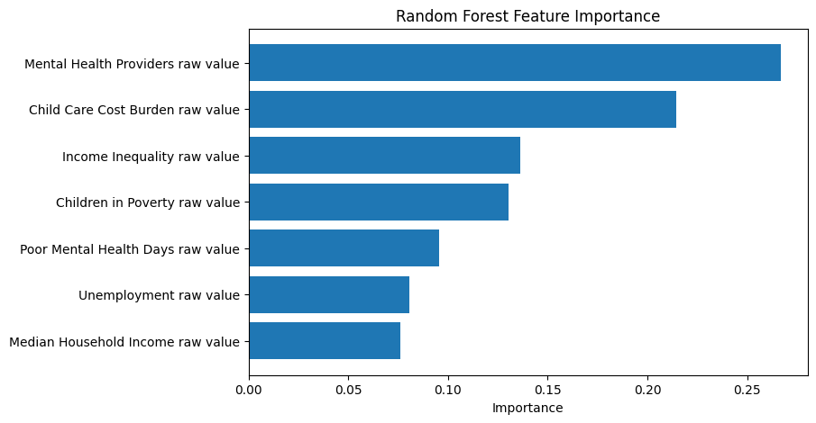
02
02
01
03
ranked features
access to mental health providers the most influential in model’s explanatory power, highlighting approach for housing intervention
BACKGROUND
ASSESSMENT
ASSESSMENT
RECOMMENDATIONS

Slide 18
02
02
01
03
future dev
complex, nonlinear interactions can be explored with a range of advanced statistical and ML methods
Cross-validation & normalization of advanced model
BACKGROUND
ASSESSMENT
ASSESSMENT
RECOMMENDATIONS
Multivariate regression, complex interactions
Expand scope with additional demographic variables and neighboring states

Slide 19
02
02
01
03
solutions exist
studying homelessness in open-source literature is on the rise–and studies have applied data science methods to fill the gap
Model | Application | What’s Missing | Citation
Supervised regression (logistic) | Predict at-risk individuals or populations | Matching units for geographical variables of interest | Hanauer, M.; et. al. (2020)
Unsupervised ML (K-means clustering) | Resource allocation for community services | Data-encoded and transparent services by providers | Huey, R.; Shoukry, Y.; Lee, M. K.; Raman, V. (2017)
BACKGROUND
ASSESSMENT
ASSESSMENT
RECOMMENDATIONS
Source: Moon, E. & Guha, R. (2024). A Human-Centered Review of Algorithms in Homelessness Research. In Proceedings of the CHI Conference on Human Factors in Computing Systems (CHI ‘24), May 11-16, 2024, Honolulu, HI, USA. https://doi.org/10.1145/3613904.3642392.
Notes:
Both of these categories–supervised and unsupervised–were covered in this course.

Slide 20
02
02
01
03
our proposal
bridging the data gap requires community collaboration
Central, open-source & anonymized data
Benefits: Accessibility, Transparency, Makes Reproducibility Feasible, Saves Time & Money
Mediums: Portals, On-Site Data Links, Reports
1
BACKGROUND
ASSESSMENT
ASSESSMENT
RECOMMENDATIONS
Connect stakeholders with students
Benefits: Training, Hiring, Real-World Exposure, Save Resources
Examples: CNM Ingenuity Capstone, Parker Dewey
2

Slide 21
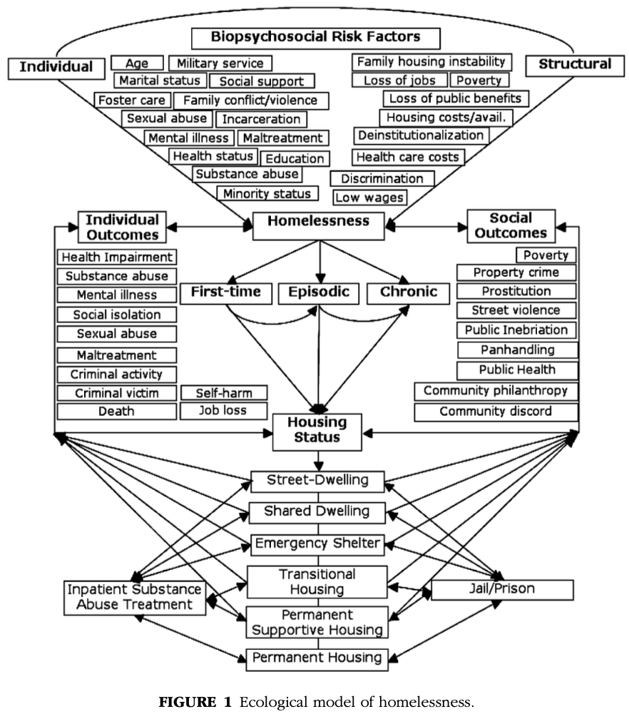
02
02
01
03
looking ahead
with data- and community-driven advocacy
Foundational Project: Applied data science methods are on the rise nationwide, and New Mexico can lead as a case study.
Improving Decisions: Open-source, anonymized data can improve resource allocation and intervention.
Community Collaboration: Quantitative and qualitative measures remain essential to understand and address the homelessness ecosystem.
BACKGROUND
ASSESSMENT
ASSESSMENT
RECOMMENDATIONS
Nooe, R. M. & Patterson, D. A. (2010). The Ecology of Homelessness.

Slide 22
02
02
01
03
thank you.
BACKGROUND
BACKGROUND
ASSESSMENT
ASSESSMENT
RECOMMENDATIONS
Eljay Smith
Celeste Fischer
Raven Otero-Symphony
Mental Health &
Housing Stability Advocate
Lived Experience • Public Interest Data
GitHub: \eljaysmithdata
Nurse, Data Scientist, Healthcare Analytics Enthusiast
LinkedIn: \celestial-nights
GitHub: \Celeste1221
Senior Data Analyst, CYFD-JJ
Data Scientist • NASA • Policy
LinkedIn: \raven-dos
GitHub: \raven-in-space
Notes:
Both of these categories–supervised and unsupervised–were covered in this course.

Slide 23
citations
02
02
01
03
Nooe, R. M. & Patterson, D. A. (2010). The Ecology of Homelessness. Journal of Human Behavior in the Social Environment, 20(2), 105-152. https://doi.org/10.1080/10911350903269757.
Hanauer, M; Watterson, K; Ragatz, M.; Macy, J. T; Sinclair, E.; & Suisman, S. (2021). Predictors of successful housing in a housing first program. Journal of Social Distress and Homelessness 30, 1 (Jan 2021), 84–89. https://doi.org/10.1080/10530789.2020.1738636.
Moon, E. & Guha, R. (2024). A Human-Centered Review of Algorithms in Homelessness Research. In Proceedings of the CHI Conference on Human Factors in Computing Systems (CHI ‘24), May 11-16, 2024, Honolulu, HI, USA. https://doi.org/10.1145/3613904.3642392.
Consolidated Planning/CHAS Data | HUD USER. (n.d.). Www.huduser.gov. https://www.huduser.gov/portal/datasets/cp.html
County Health Rankings & Roadmaps. (2024). Health Data | County Health Rankings & Roadmaps. Www.countyhealthrankings.org. https://www.countyhealthrankings.org/health-data
Pennsylvania State University. (2018a). 2.3 - The Simple Linear Regression Model | STAT 462. Online.stat.psu.edu. https://online.stat.psu.edu/stat462/node/93/
Pennsylvania State University. (2018b). 10.7 - Detecting Multicollinearity Using Variance Inflation Factors | STAT 462. Online.stat.psu.edu. https://online.stat.psu.edu/stat462/node/180/
Potters, C. (2024, June 27). Variance Inflation Factor Definition. Investopedia. https://www.investopedia.com/terms/v/variance-inflation-factor.asp
US Census Bureau. (2021). American Community Survey (ACS). Census.gov. https://www.census.gov/programs-surveys/acs
BACKGROUND
ASSESSMENT
ASSESSMENT
RECOMMENDATIONS
Notes:
Both of these categories–supervised and unsupervised–were covered in this course.

Slide 24
APPENDICES

Slide 25
Appendix 1:
modeling workflow
Cleaned County Health Rankings data
Selected NM counties only
Chose housing, mental health, and economic variables
Ran EDA, correlations, OLS models, random forest, and clustering

Slide 26
Appendix 2: Dataset Information
County Health Rankings and Roadmaps 2025 | University of Wisconsin Population Health Institute in partnership with the Robert Wood Johnson Foundation Integrates data from various federal and state agencies into a single county-level dataset
HUD Comprehensive Housing Affordability Strategy (CHAS) data | U.S. Department of Housing and Urban Development Integrates data from ACS
American Community Services (ACS) | U.S. Census Bureau
HUD Point In Time (PIT) Counts | U.S. Department of Housing and Urban Development

Slide 27
Appendix 2: feature dictionary
Severe Housing Cost Burden raw value | Percentage of households that spend 50% or more of their household income on housing.
Children in Poverty raw value | Percentage of people under age 18 in poverty.
Unemployment raw value | Percentage of population ages 16 and older unemployed but seeking work.
Income Inequality raw value | Ratio of household income at the 80th percentile to income at the 20th percentile.
Child Care Cost Burden raw value | Number of child care centers per 1,000 population under 5 years old.
Median Household Income raw value | The income where half of households in a county earn more and half of households earn less.
Mental Health Providers raw value | Number of mental health care providers per 100,000 population
Poor Mental Health Days raw value | Average number of mentally unhealthy days reported in past 30 days (age-adjusted).

Slide 28
Appendix 3:
EDA - County Extremes
Harding County: 0 mental health providers
Los Alamos: high providers, high income, low burden
McKinley: high poverty / high need indicators
Taos: high housing burden signal
Median Household Income = economic context

Slide 29
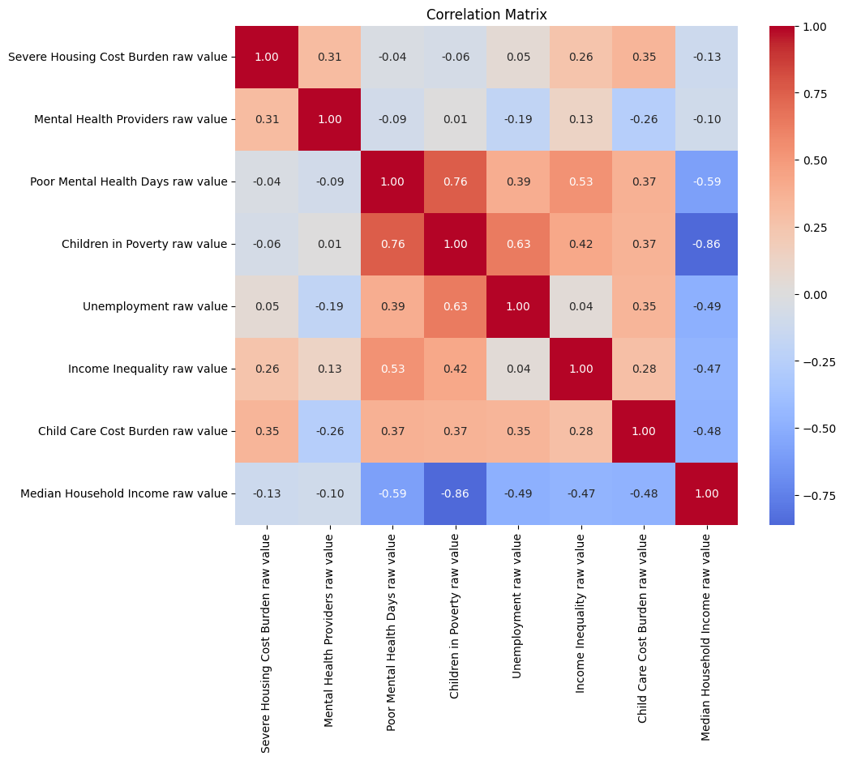
Appendix 4: correlation matrix
Children in poverty and median household income are strongly negatively correlated
Poor mental health days acts like a socioeconomic indicator (similar to poverty or median household income)
Mental health providers is not strongly correlated to socioeconomic indicators

Slide 30
Appendix 7a
02
01
03
County clustering with K-Means
BACKGROUND
Purpose
ASSESSMENT
Key Finding
RECOMMENDATIONS
Four County Profiles
Why This Matters
Identify groups of counties with similar housing and mental health characteristics
🏙️ Higher-income counties with high housing burden
🏥 Lower-income counties with greater provider access
🌾 Rural counties with limited provider access and higher mental health burden
⭐ Los Alamos County (unique socioeconomic outlier)
Different county profiles may benefit from different policy approaches rather than a one-size-fits-all solution
County clustering demonstrates that New Mexico's housing and mental health challenges are not uniform. Different county profiles may require different combinations of housing, economic, and mental health interventions to improve community outcomes.

Slide 31
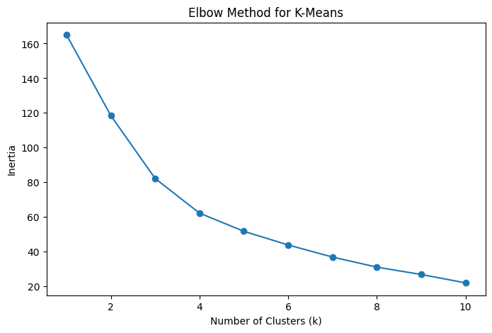
Appendix 7b - the elbow method
02
01
03
A graphical technique used in machine learning to find the optimal number of clusters (often represented as k) in a dataset, primarily for K-Means clustering It helps identify the exact point where adding more clusters yields diminishing returns, preventing under-fitting and over-fitting.
BACKGROUND
ASSESSMENT
RECOMMENDATIONS
https://www.geeksforgeeks.org/machine-learning/elbow-method-for-optimal-value-of-k-in-kmeans/

Slide 32
Appendix 8:
modeling limitations
Small sample size: only NM counties
County-level data hides individual experience
Correlation ≠ causation
Public data does not link people across housing and healthcare systems
Results are exploratory, not definitive

Slide 33
ARCHIVE

Slide 34
02
02
01
03
TEST
RAVEN TO EXPLAIN
BACKGROUND
ASSESSMENT
ASSESSMENT
RECOMMENDATIONS
WILL ELABORATE OVER THE WEEK IF TIME

Slide 35
The “BAR” Team ;)
BACKGROUND: INTRO, OUR TEAM, RESEARCH / INTERVIEW, QUESTION
ASSESSMENT: DATA SOURCES, IDA / EDA, VISUALS
RECOMMENDATION: RESULTS, PROPOSAL, FUTURE DEVELOPMENT
TAB ORDER:
Check to make sure the side tabs match (in bold) across slides:
BACKGROUND | Title - Title Slide - Eljay
ALL | Our Team - Our beautiful faces :) - pass from Celeste > Raven > Eljay
BACKGROUND | Research - research, SME interview, etc. - setting the stage - Eljay
BACKGROUND | Question - research, SME interview, etc. - setting the stage - Eljay
ASSESSMENT | Data Sources - what we found (the list you created) - Celeste
ASSESSMENT | Selection - what we selected (variables of interest) - Celeste
ASSESSMENT | EDA - (gaps) limitations we discovered from EDA (our “oh shit” moment) - Celeste
RECOMMENDATION | Visualizations - show map to demonstrate apples to oranges - Raven
RECOMMENDATION | Solution - involve the audience, propose community effort - Raven
RECOMMENDATION | Looking Ahead - what we can do WITH YOUR HELP!!!!!!!! - Raven

Slide 36
our approach
02
01
04
05
06
07
03
08
We combined stakeholder input, literature review, and public-data assessment.
Project constraint: publicly accessible datasets only
INTRO
DATA
APPROACH
QUESTION
WHY IT MATTERS
WHY IT MATTERS
OBSTACLE
MISSING PIECES
question
data
data
goal
Can healthcare access and housing stability be connected using public data?
PIT counts
County Health Rankings
Provider Data
Census Data
Identify measurable relationships and actionable insights
Notes:
Our initial plan was straightforward.
We identified multiple public datasets that appeared relevant to the question and began evaluating how they could be combined.
We collected homelessness data, healthcare access measures, provider information, and demographic indicators.
At this point in the project, we believed the primary challenge would be analysis.
We soon discovered that the real challenge was the data itself.

Slide 37
main obstacle
02
01
03
The obstacle was not a total lack of public data. It was a lack of compatible, linkable, publicly accessible data.
Different geographic units
Different populations and time periods
Provider availability did not equal actual access
PIT counts measured visible homelessness on one night, not individual housing stability over time
No link between healthcare use and later housing outcomes
BACKGROUND
ASSESSMENT
RECOMMENDATIONS
We chose not to force incompatible data into a predictive or causal model

Slide 38
pieces, not pathways
02
01
04
05
06
08
03
07
PICKUP and HOMES provide important insight into homeless in New Mexico, but public data still cannot connect healthcare access, treatment, and housing outcomes over time.
PICKUP
HOMES
INTRO
DATA
APPROACH
QUESTION
WHY IT MATTERS
LOOKING AHEAD
OBSTACLE
MISSING PIECES
Notes:
"I conducted an informational interview with Korina, Executive Director of Healthcare for the Homeless at La Familia in Santa Fe. Together we discussed questions professionals in the field would like answered. One question stood out: Is there a measurable relationship between healthcare access and housing stability outcomes?"

Slide 39
02
01
04
05
06
08
03
“
07
the question
Can public data help us understand the relationship between healthcare access and housing stability in New Mexico?
INTRO
DATA
APPROACH
QUESTION
WHY IT MATTERS
LOOKING AHEAD
OBSTACLE
Healthcare access
Housing stability
New Mexico
MISSING PIECES
”
*Exploratory - not a causal claim.
Notes:
"I conducted an informational interview with Korina, Executive Director of Healthcare for the Homeless at La Familia in Santa Fe. Together we discussed questions professionals in the field would like answered. One question stood out: Is there a measurable relationship between healthcare access and housing stability outcomes?"

Slide 40
data
ACKNOWLEDGE that research papers confirmed this missing data. We are the only open-source study to investigate the link between homelessness and mental healthcare. That was a big discovery.
02
01
04
05
06
07
03
08
Discovery, selection, and initial data analysis
OBSTACLE
MISSING PIECES
DATA
INTRO
APPROACH
QUESTION
WHY IT MATTERS
homelessness
healthcare
geography
LOOKING AHEAD
HUD/New Mexico Coalition to End Homelessness Point-in-Time counts
Albuquerque CoC and “Balance-of-State” CoC for PIT counts
Aggregate counts, not individual outcomes
County Health Rankings
Provider locations and population measures
Availability, not actual service use
County vs. CoC reporting
Different boundaries and populations
No reliable direct linkage

Slide 41
homelessness,
Colors not final
01
02
04
05
06
07
03
08
healthcare access,
and the limits of public data.
BACKGROUND
DATA
WHY IT MATTERS
QUESTION
LOOKING AHEAD
APPROACH
OBSTACLE
MISSING PIECES
Stakeholder-informed research
CNM Ingenuity Deep Dive Data Science Bootcamp Capstone
Eljay Smith
Raven Otero-Symphony
Celeste Fischer
6.26.2026
Investigating what public data can—and cannot—tell us about healthcare access and housing stability in New Mexico.
Notes:
We began this capstone with a simple goal: investigate a question that matters to professionals working directly in homelessness services.
Rather than starting with a dataset, we started with a real-world problem and asked whether public data could help us understand it.
What we discovered ultimately changed the direction of the project.

Slide 42
the context
01
03
01
02
our question focused on one relationship within a larger system
Housing Services
Transportation
HOUSING STABILITY
INTRO
BACKGROUND
ASSESSMENT
Justice & reentry
RECOMMENDATIONS
Income & Benefits
Behavioral, Psychiatric & Substance Use Treatment Access
Primary
Healthcare

